Slide 1
Day 3: Sharing plans, data and code
Anna Nowakowska, Mahmoud Elsherif, David Souto
School of Psychology and Vision Sciences

Slide 2
Session 1: Pre-registration and registered reports

Slide 3
Session 2: Version Control with GitHub
What is version control? GitHub
Notes:
The goal of the session is to show you how to use GitHub to share your code (ordocumentation) and use it as a way to collaborate with people efficiently. We shallsee that we can grasp the basic functionality in short time. Going through all theintricacies would take a lot longer, but one of the reasons GitHub is so popular isthat it simplified version-control via git for most common tasks. For instance, wecan synchronize files via a visual interface (GitHub Desktop) instead of using thecommand line.For small projects, where you often have 1-2 people working on code, this crashcourse should be enough to get you started. Even if you don’t intend to publishyour code GitHub is a good way of keeping track of versions and sharing it withfuture collaborators as you will be ale to revert to previous versions & resolveconflicts more easily than if everyone had independent copies, with file dates andnames (“analysis_last_final_v5.R”) as the only way to keep track of the lastversion.Other advantages of using GitHub: - Facilitates collaboration with others. - Allowsyou to back up your code online (not the data)- Allows to showcase your work and keep track of how people interact with it;providing proof of impact.
For small projects, where you often have 1-2 people working on code, this crashcourse should be enough to get you started. Even if you don’t intend to publishyour code GitHub is a good way of keeping track of versions and sharing it withfuture collaborators as you will be ale to revert to previous versions & resolveconflicts more easily than if everyone had independent copies, with file dates andnames (“analysis_last_final_v5.R”) as the only way to keep track of the lastversion.Other advantages of using GitHub: - Facilitates collaboration with others. - Allowsyou to back up your code online (not the data)- Allows to showcase your work and keep track of how people interact with it;providing proof of impact.

Slide 4
Terminology
[Schematic]

Slide 5
Tour of GitHub Desktop
[visual tour of interface]

Slide 6
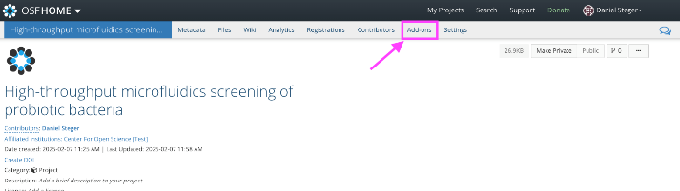
Integration with OSF
Connect to GitHub on the OSF

Slide 7
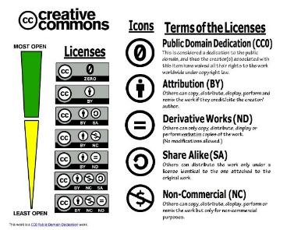



Licensing that encourages reuse
Text / articles: The Creative Commons 4.0 license
Code: BSD-2-Clause license, MIT License, GNU GPL.
This work is a CC0 Public Domain Dedication.
Notes:
The Creative Commons 4.0 license: common with educational resources or articles. It is a very non-restrictive license; you simply need to attribute authorship and re-share with the same license.
Not always appropriate for code. BSD-2-Clause license, common for code.
Use this infographic to understand the various CC licenses and their terms. ​​​​​This work is a CC0 Public Domain Dedication.

Slide 8
Session 3: Publishing
Pre-printing, reporting guidelines, picking journals, peer review

Slide 9
Pre-printing
File-drawer problem
Gatekeeping
Publication delays

Slide 10
Reporting guidelines

Slide 11
Pick a journal

Slide 12
Share data & materials: What’s FAIR?

Slide 13
Practicalities in sharing data
Anonymous links to data / code during reviewing
Hosting data: Pick the platform that will add the most value
OSF
Zanado?
Share as much as you can given ethical implications.
Facilitates the work of others.
Metanalyses.
Enhances the value of your work.

Slide 14
Peer review
What should you expect?

Slide 15
Manuscript versions
Update the author manuscript (you have the copyright) alongside the published version (you might have not!)

Slide 16
Workshop feedback

